Slide 1
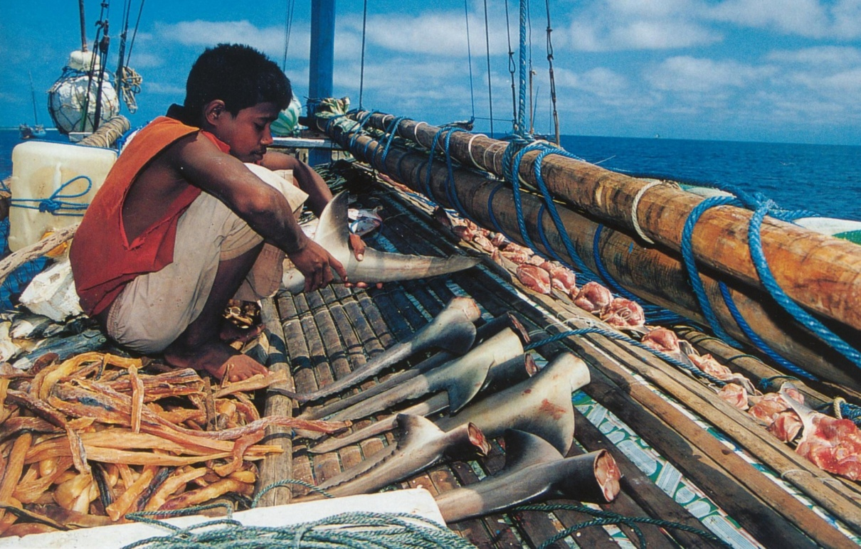
Taken out of context: the effects of shark removal in the dynamic environment of a coral reef
Jonathan L.W. Ruppert, Mike Travers, Marie-Josée Fortin and Mark G. Meekan
Notes:
Reef shark declines: Consequences for the trophic structure of communities of coral reef fishes

Slide 2
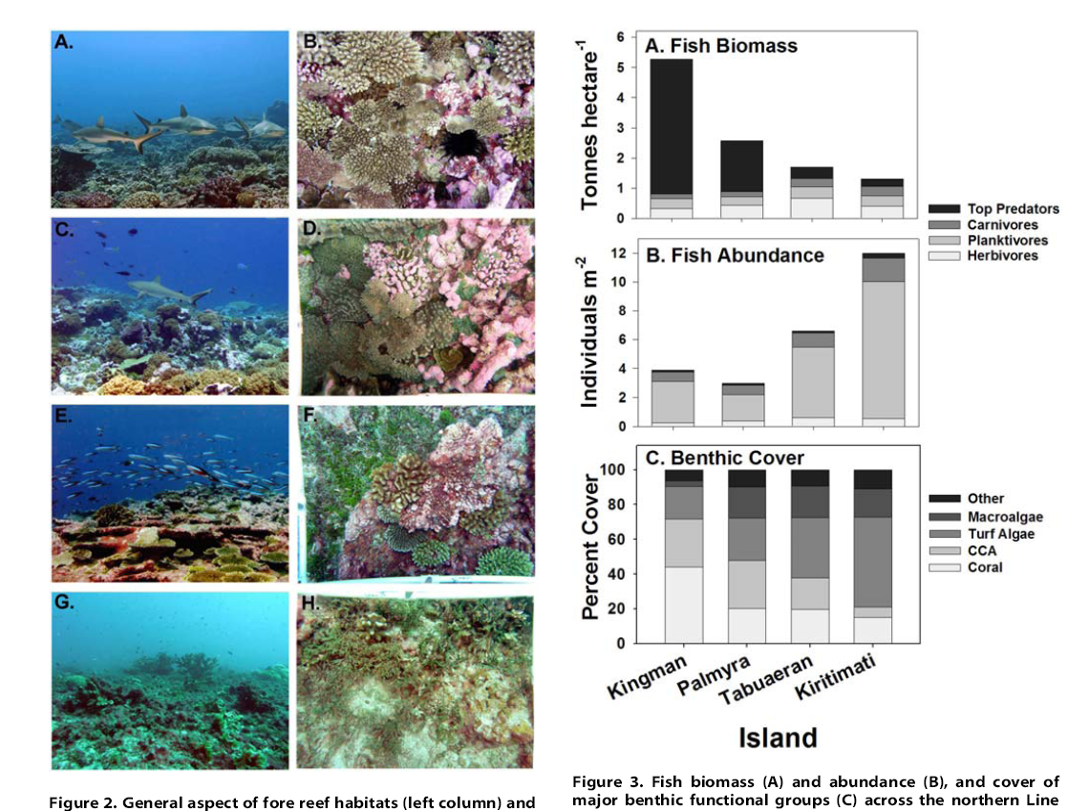
Coral Reefs: Human Activity or Top–Predators?
High numbers sharks – high coral cover, absent – low coral cover
Changes in trophic structure of fish communities
Confounding of human activity (fishing down food chain) and natural disturbance
Sandin et al. 2008 PLoS ONE
Notes:
Coral Reef Resilience

Slide 3
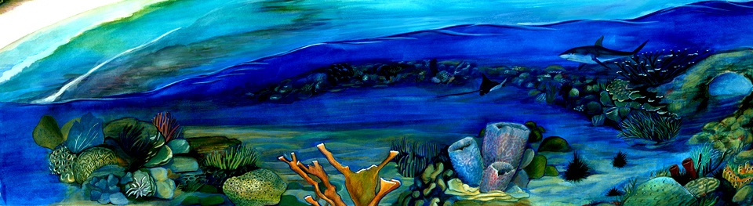
Aims
Does fishing impact shark abundance?
Do changes in the abundance of sharks affect the structure of the reef fish community?
How do benthic disturbances (cyclones, bleaching) alter fish communities?
Are there synergistic effects of these top-down and bottom-up processes?

Slide 4
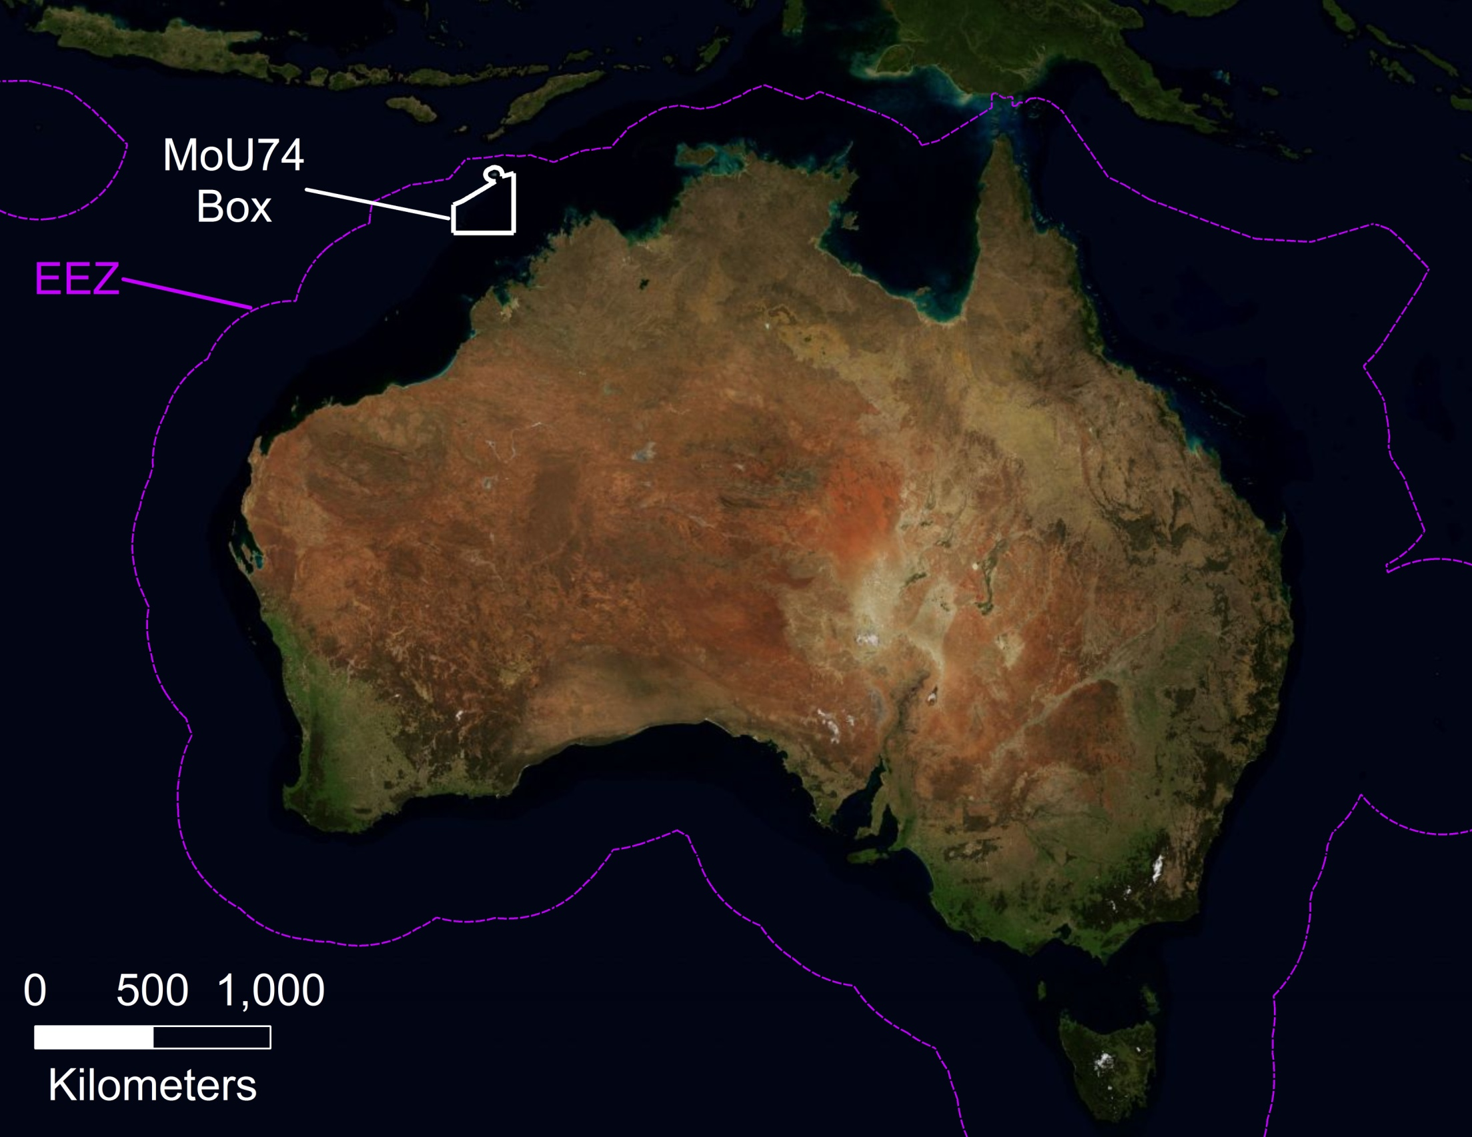
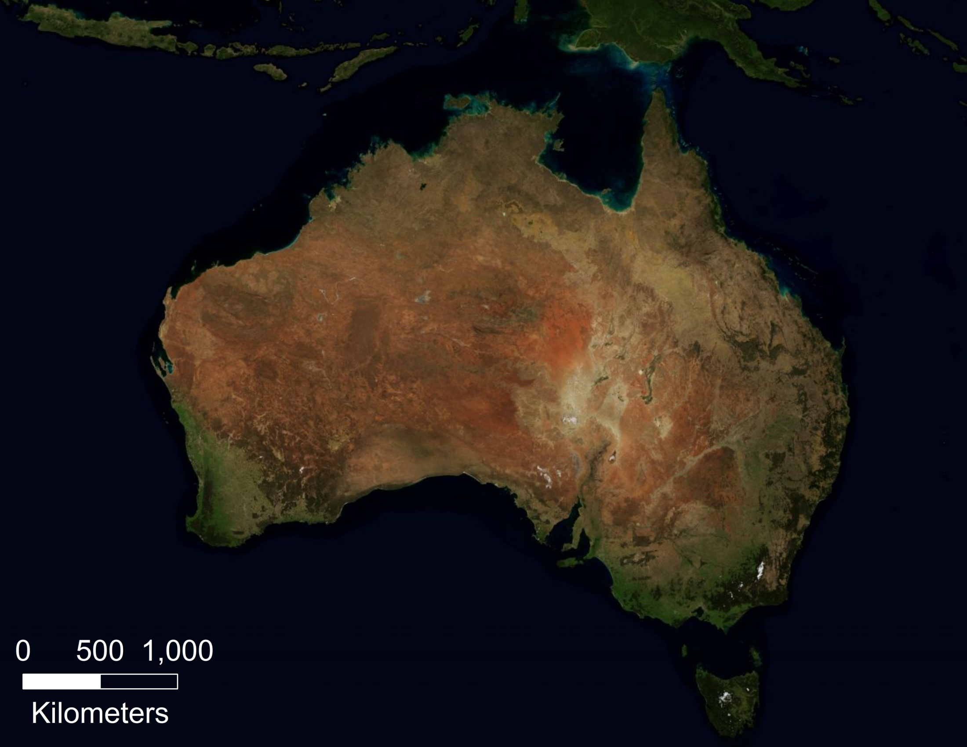
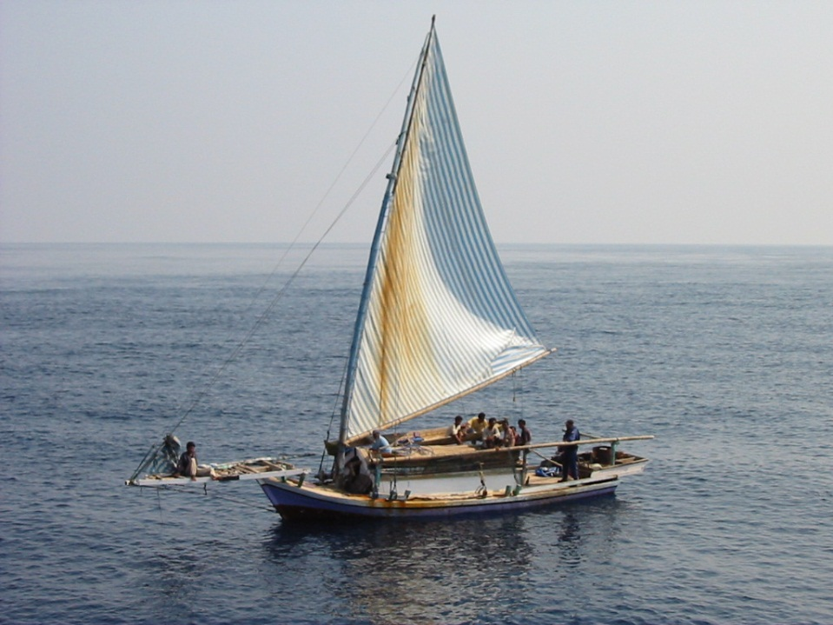
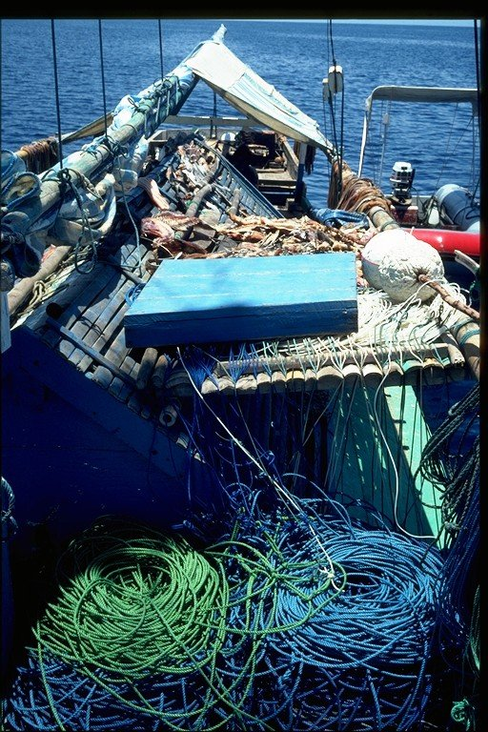
Notes:
Sample sites experience difference in fishing pressure due to management.

Slide 5
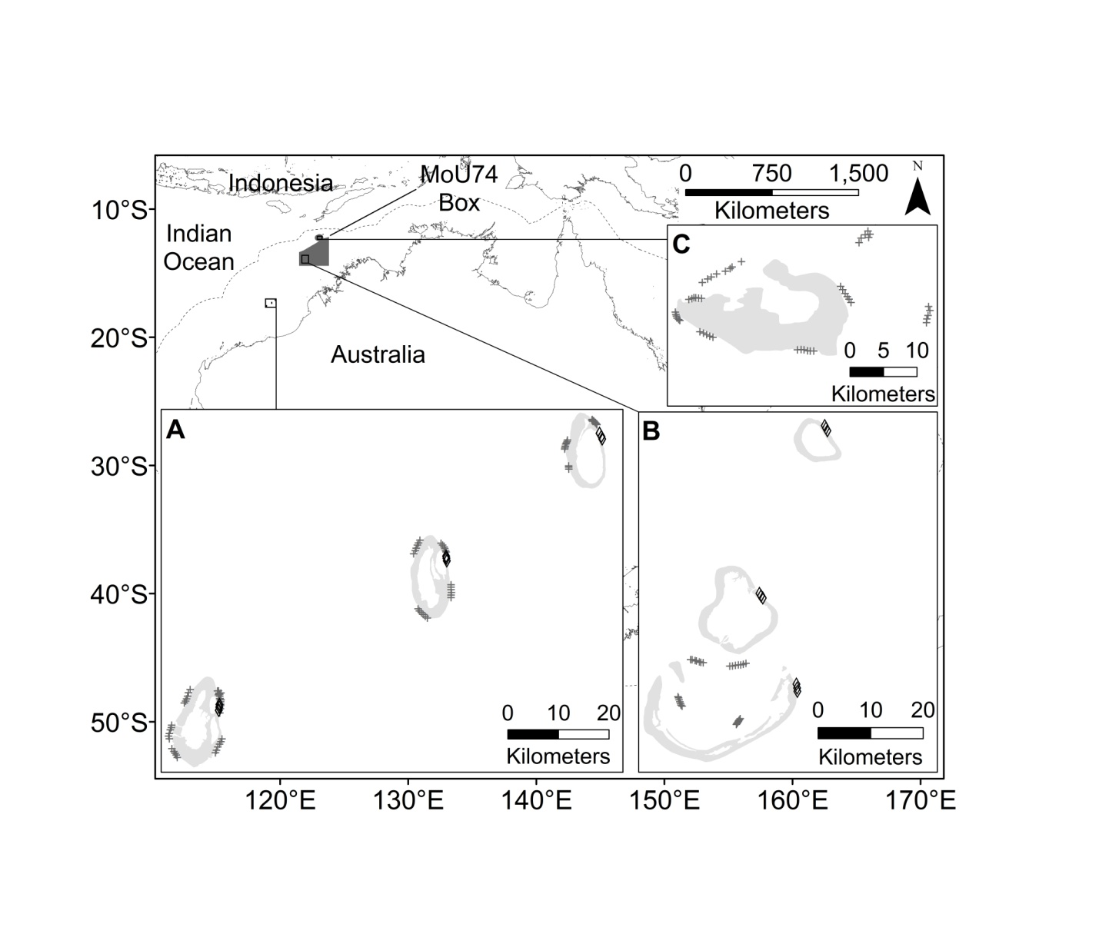
Ashmore (Fished)
Rowley Shoals (Non-Fished)
Scott Reefs (Fished)
Notes:
Sample sites

Slide 6
Fished Reefs: Coral Bleaching
Notes:
Benthic degradation: Scott (Bleaching 1998; Cyclone 2004)

Slide 7
Non-Fished Reefs: Cyclonic Event
Notes:
Benthic degradation: Rowley (Cyclone 1996; Minor Bleach 2005)

Slide 8
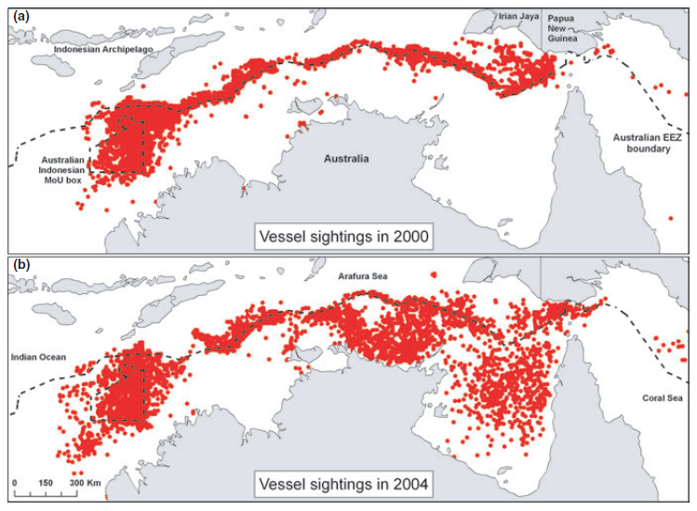
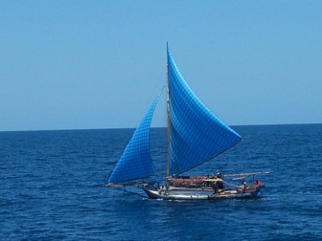
Treatments: Fishing and Disturbance
Fishing (Fished vs.
Non-Fished)
  Shark density differences between Rowley and Scott
Disturbance (Disturbed vs. Non-Disturbed)
  < 30% coral cover threshold
Scott Reefs
Rowley Shoals
30%
Coral
Cover
Notes:
This means that we have two main effects. Definition of effects.

Slide 9
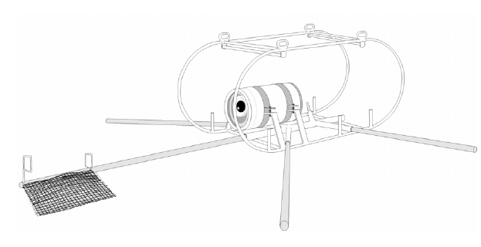
Shark Community Data: BRUVS
BRUVS (Baited Remote Underwater Video Station)
  All reefs (2003/2004)
  Target apex predators & carnivores
  Depth range: 5 – 100 m
  1 to 1.5 hrs per drop
  MaxN statistic
Notes:
Sampling

Slide 10
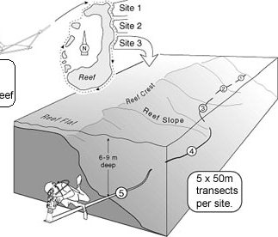
Trophic Structure of Coral Reef Fishes
AIMS LTMP (Long-Term Monitoring Program)
  Scott and Rowley (1994 – Present)
  6 reefs; 3 sites each (n=18)
  Northeast reef slope
  Benthic surveys alongside
  Abundance counts (18
  families; non-cryptic
  species; excludes recruits)
SOURCE: AIMS
Notes:
Sampling. Will not spend too much time here. Information is online.

Slide 11
Results: Shark Density (permuted ANOVA)
n = 94
p < 0.01
α = 9
n = 46
n = 28
α = 5
α = 5
Notes:
Overall trends.

Slide 12
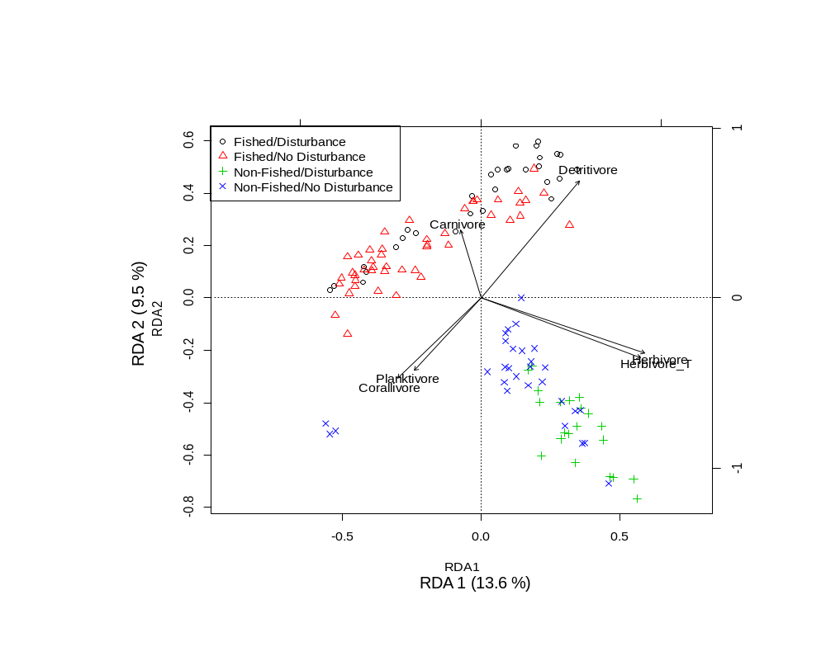
Differences in Trophic Structure (RDA)
Fished vs. Non-Fished:
Carnivores & Herbivores (Territorial & Non – Territorial)
Disturbance vs. Non-Disturbance:
Herbivores, Planktivores, Corallivores, and Detritivores
Notes:
Species composition constrained to trophic groups. Explains 30% in species variation. No partial.

Slide 13
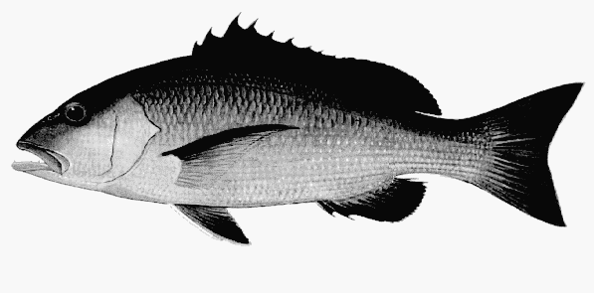
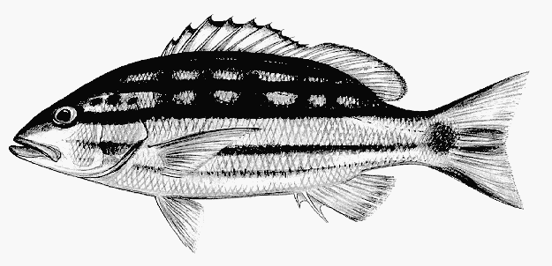
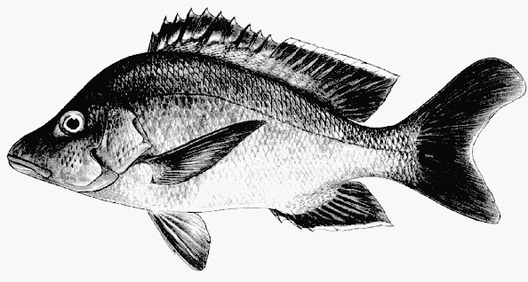
Trophic Group Responses: Carnivores
*
* p < 0.05
** p < 0.01
Density Km⁻² (mean ± 95%CI)
Notes:
Synergistic Effects.

Slide 14
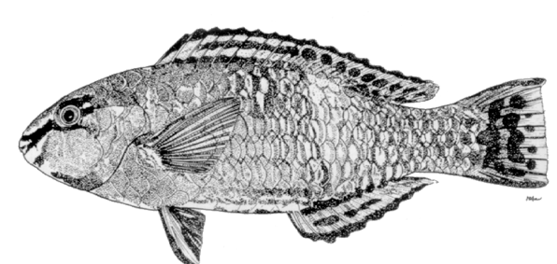
Trophic Group Responses: Herbivores
**
**
*
* p < 0.05
** p < 0.01
Density Km⁻² (mean ± 95%CI)
Notes:
Synergistic Effects.

Slide 15
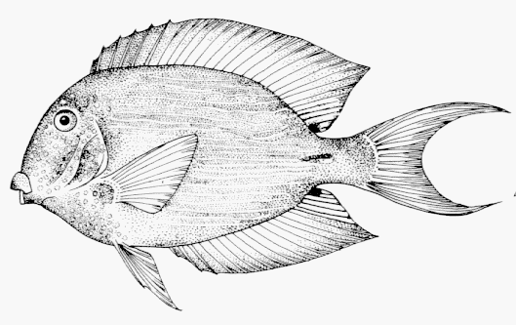
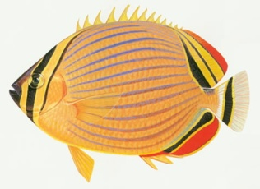
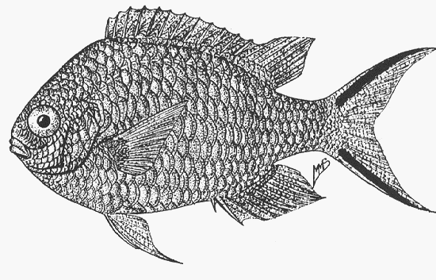
Trophic Group Responses
**
**
**
Density Km⁻² (mean ± 95%CI)
**
**
Notes:
Synergistic Effects.

Slide 16
Summary
Does fishing impact shark abundance?
  YES
Do changes in the abundance of sharks affect the structure of the reef fish community?
  YES
  Meso-predator release of carnivores and subsequent trophic cascade during disturbances with herbivores
Do benthic disturbances alter fish communities? Are there synergistic effects of top-down and bottom-up processes?
  YES
  Herbivores, planktivores and corallivores show responses to changes in coral and algal cover
  Detritivores show synergistic responses
Notes:
*Resilience of coral reefs – herbivores different in a mesopredator rich environment
Summarize objectives and leave with focus on the importance of considering bottom-up and top-down effects.
Take-home message is that when we are investigating the impacts of top-down processes in coral reefs, we need to consider bottom-up effects due to the inherent synergisms that may produce responses in the fish community.

Slide 17
Significance: Resilience
Herbivores – more abundant on unfished reefs where more sharks are present
Central to recovery of reefs from processes that result in the loss of coral cover
Implications for reef resilience
Notes:
Coral Reef Resilience

Slide 18






Acknowledgements
Field/lab assistance
Dr. Jim Underwood
Mike Cappo
AIMS Monitoring Team
Conrad Speed
Owen O’Shea
Rachelle Ninio
Funding/Data
Places
Helpful Insights
Dr. Donald Jackson
Dr. Brian Shuter

